Slide 1
Disaster Management System
Shalvi Ulhas Kubal
001027262
Application Engineering Development

Slide 2
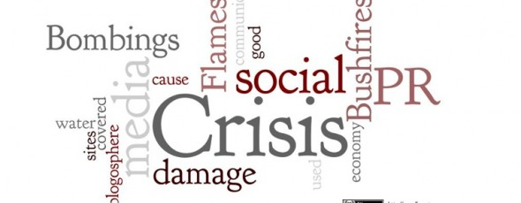
Problem Statement
The human race has always faced challenges when hit by a natural or man-made disaster. Eg. flood, forest-fires, cyclones, pandemics etc.
Basic necessities like food, health care products often go out of stock at such times
What is needed in such times of crises is catering to those in need at least for the basic necessities.
[imsrc]:groundfloormedia

Slide 3
Proposed Solution
The proposed solution is to provide all basic necessities as a combined effort.
The system administrator will create state and state administrators(network)
State Admins will handle crises situation in their state by creating various enterprises like Food bank, Hospitals, Police Departments, NGO’s(Considering four enterprises in this scope)
Victim registers, reports a disaster and requests for the supplies.
The requests are directed to the all enterprise in that zip code area to handle requests in their scope.
The Enterprise can handle the request and even request other enterprise to complete it.

Slide 4
Workflows
Victim raises food request
All food banks in that zip code receive the request
Any one food bank processes the request by itself and the packagers pack the food packets
Delivery man delivers the request or foodbank request NGO enterprise in that Zip code to deliver the request
Victim raises medical request
All Hospital in that zip code receive the request
Any one hospital assigns the request to itself and further processing is carried by hospital staff and doctors
The Hospital can forward the request to police Department if police force is needed.
Victim raises police force request
All police departments in that zip code receive the request
Any one police department assigns the request to itself and further processing is carried by police officers
The Police Department can forward the request to Hospital in case of medical emergency.

Slide 5
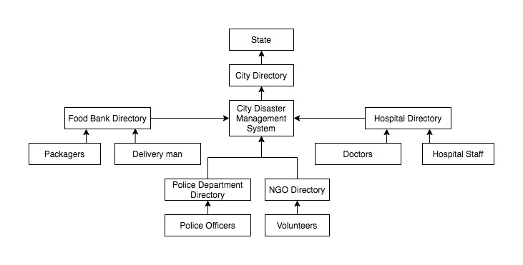
Network, Enterprise, Organization and Roles

Slide 6
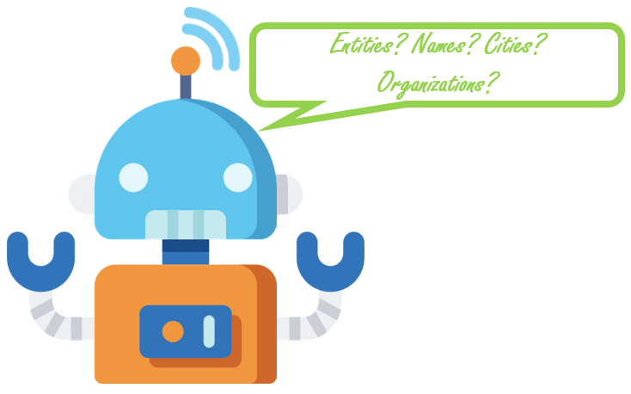
Main Entities
User Account: The functionalities will change depending on the role.
Request Queue: This will contain all the requests in all domains.
State: This will contain state name and its admin.
City: There will also be a user account in state to manage that state and its disaster management bureau.
City disaster management bureau: This will hold the directory of all the food banks, hospitals, police departments, NGO’s enterprises in their area.
Food bank: It will have the number of food packets, delivery man organization, packagers organization and a admin organization to manage that food bank.
Police Department: It will have police officers organization and admin organization to manage that police department.
Hospital: It will hospital staff organization, mobile physicians/doctors organization and admin organization to manage that hospital.
NGO: It will have volunteers organization and admin organization to manage that NGO.

Slide 7
Ecosystem Diagram

Slide 8
UML

Slide 9
DEMO

Slide 10

Future Scope
This project can be extended to include all states in country or inter country (Present deals with cities in state)
More entities like Fire Fighter, Army, Red Cross etc can also be added
Inter- network requests can be made so that any network in emergency can get help from other network

Slide 11
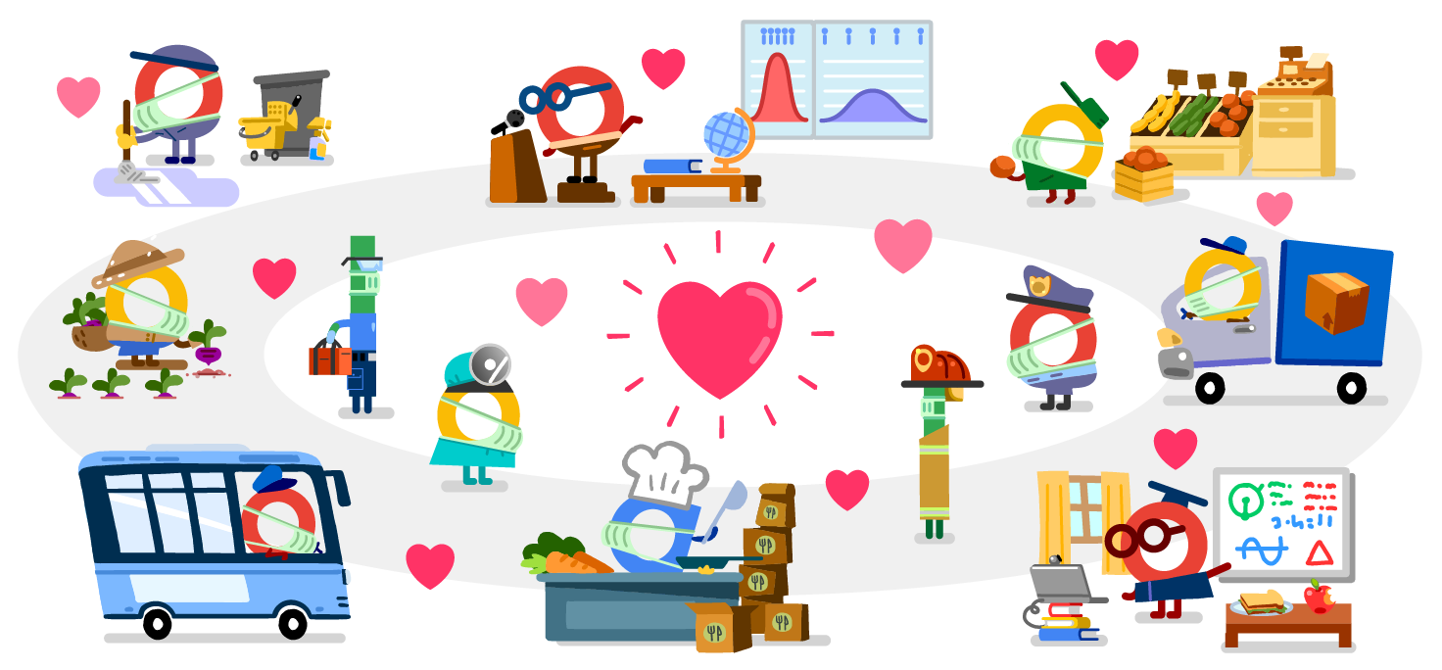
Thank You!!!

